Slide 1
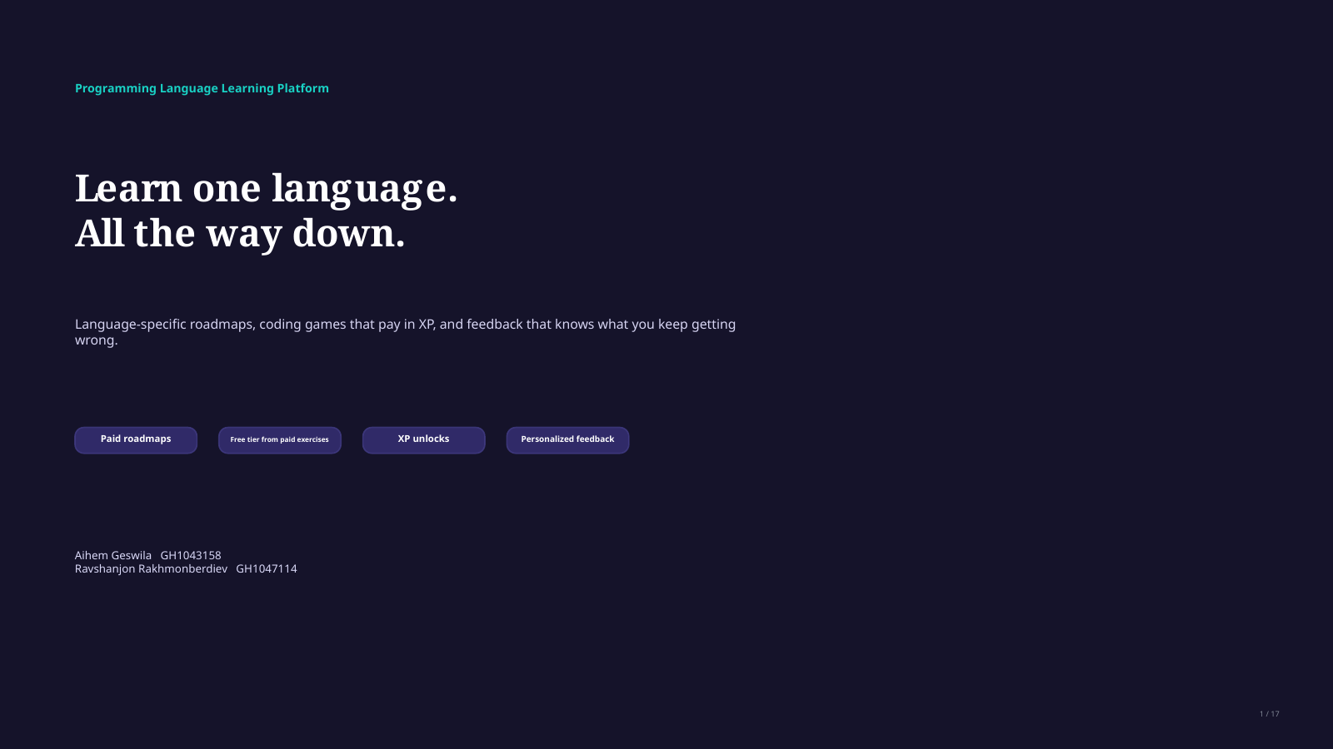

Slide 2
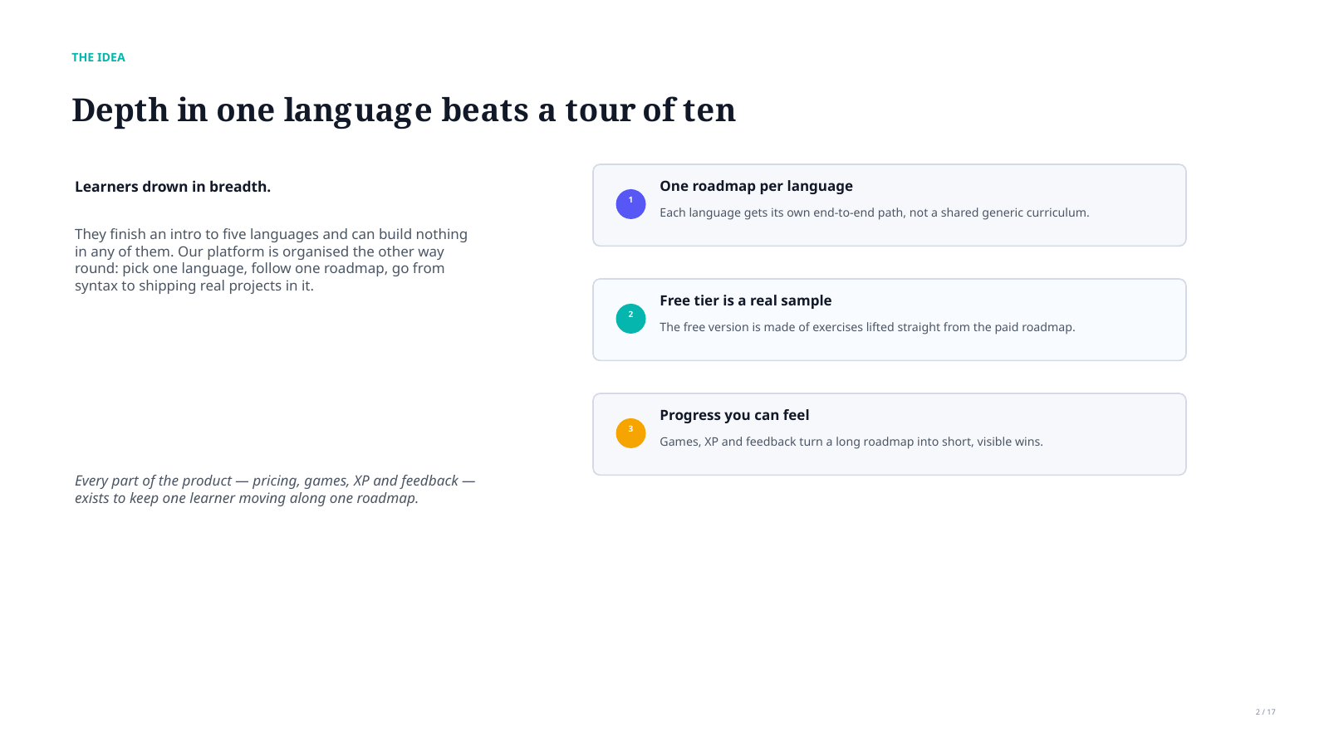

Slide 3
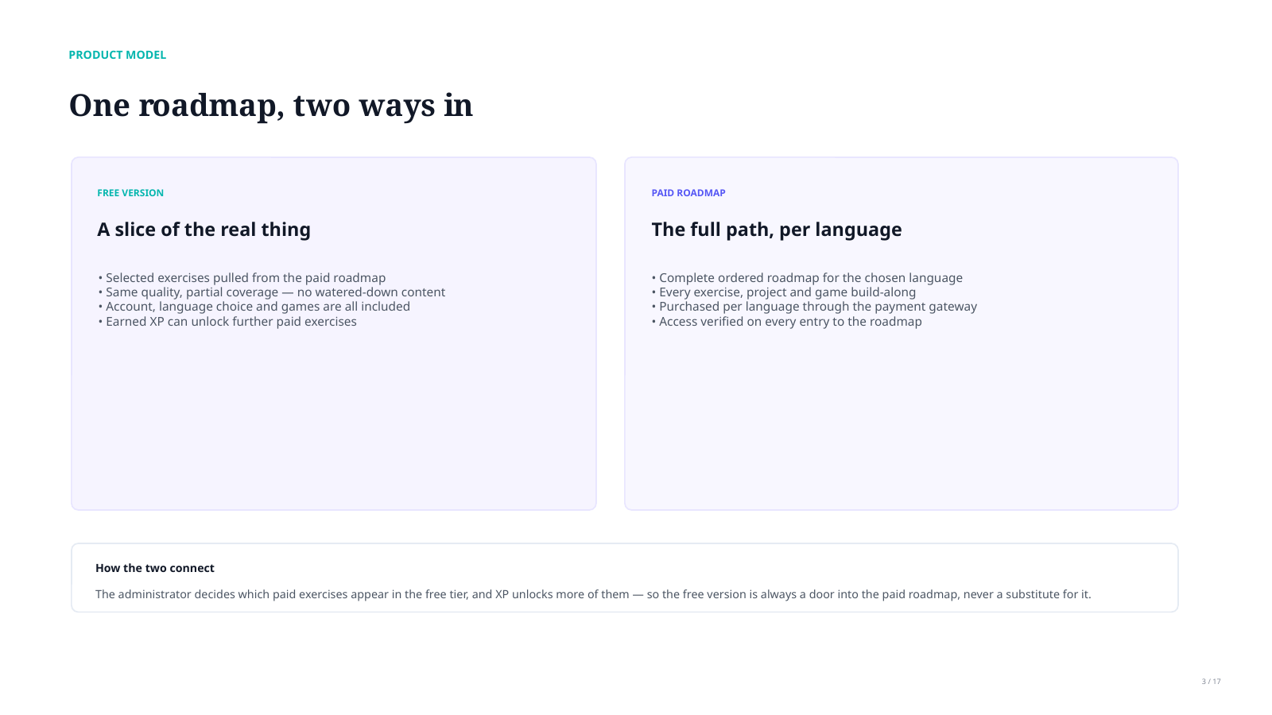

Slide 4
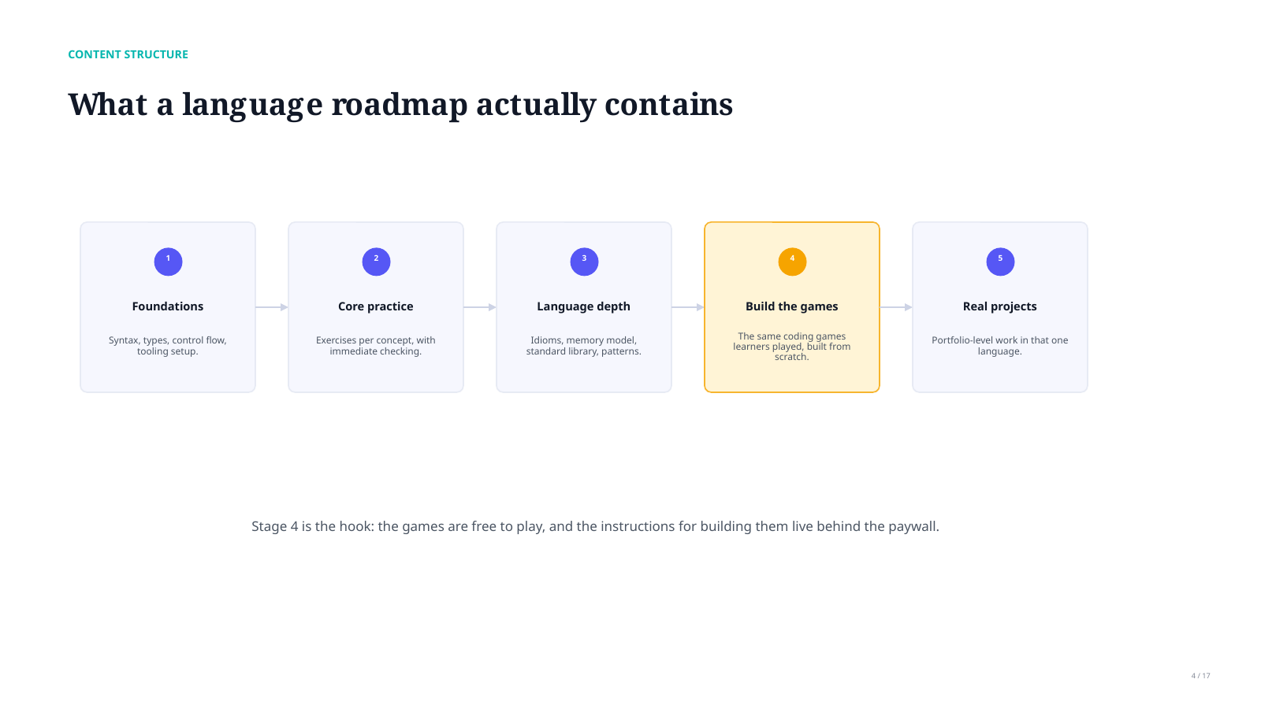

Slide 5
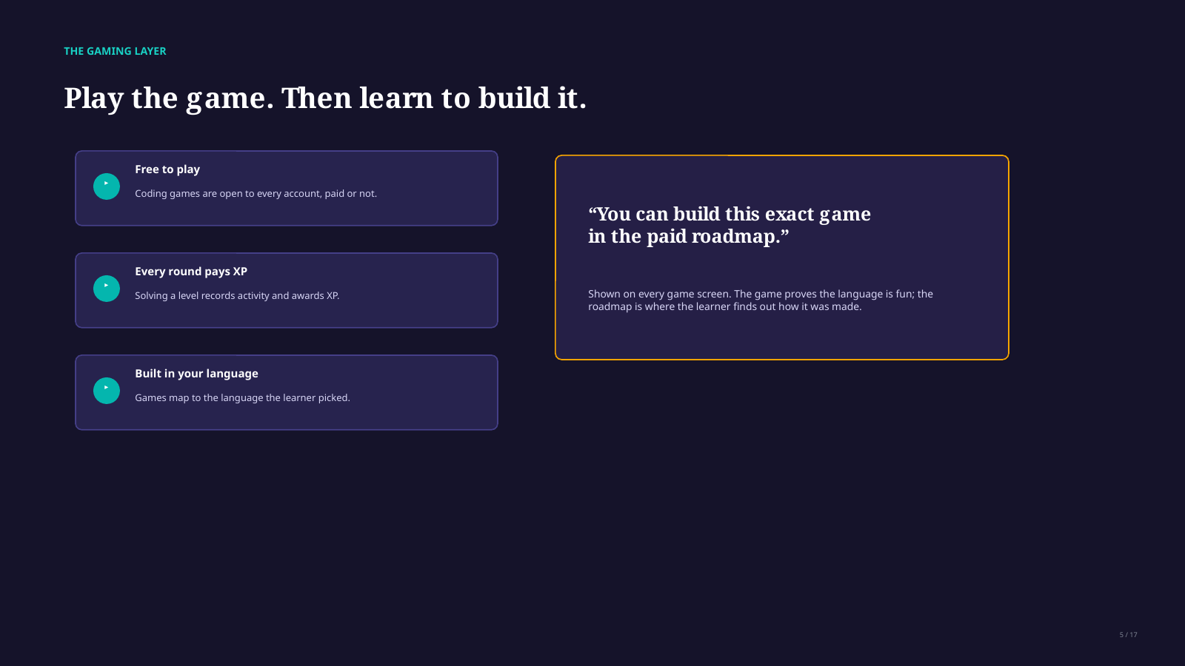

Slide 6
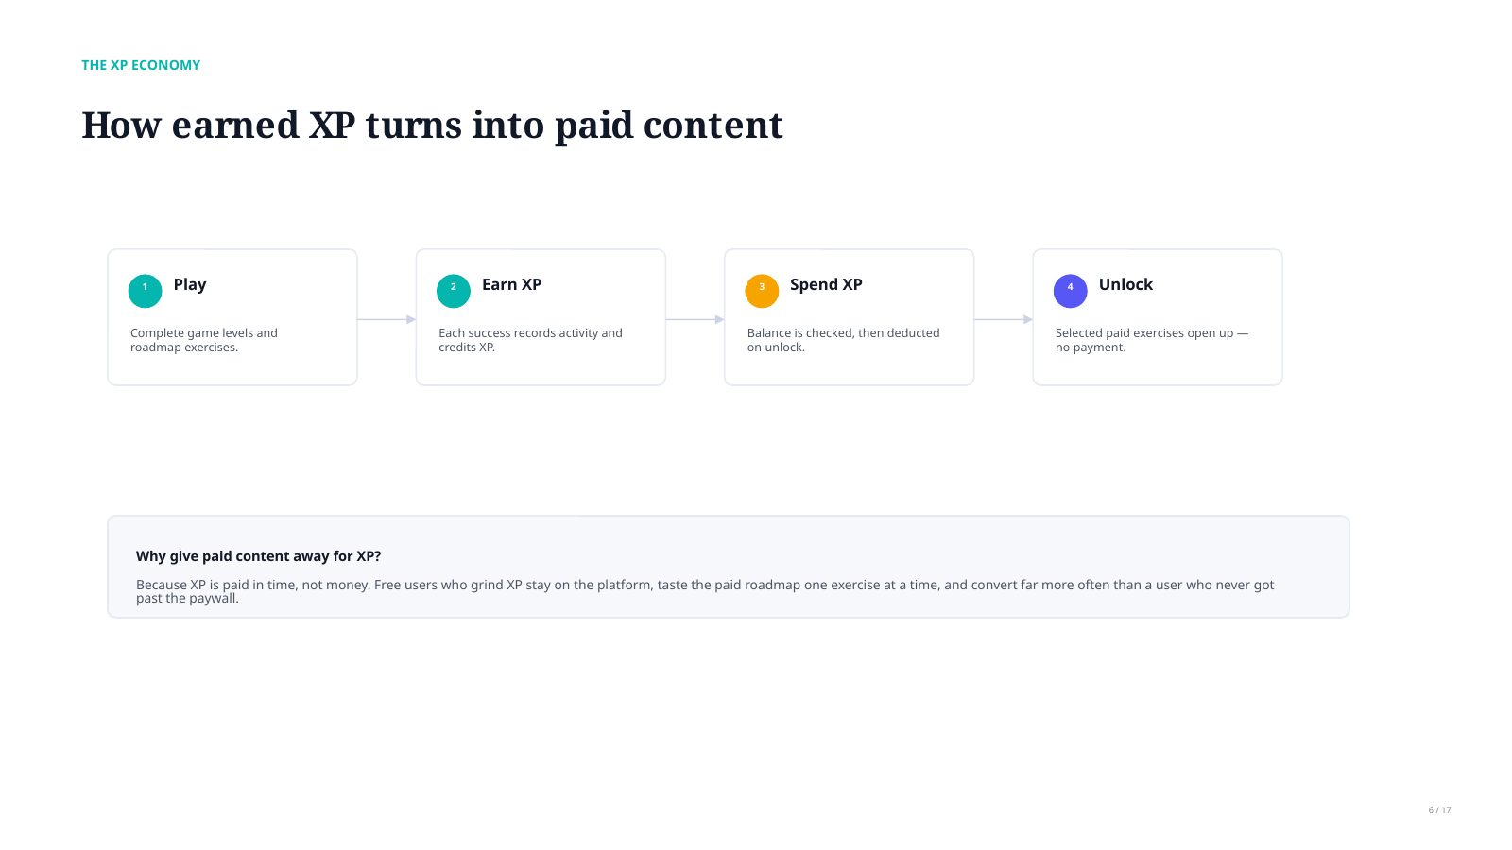

Slide 7
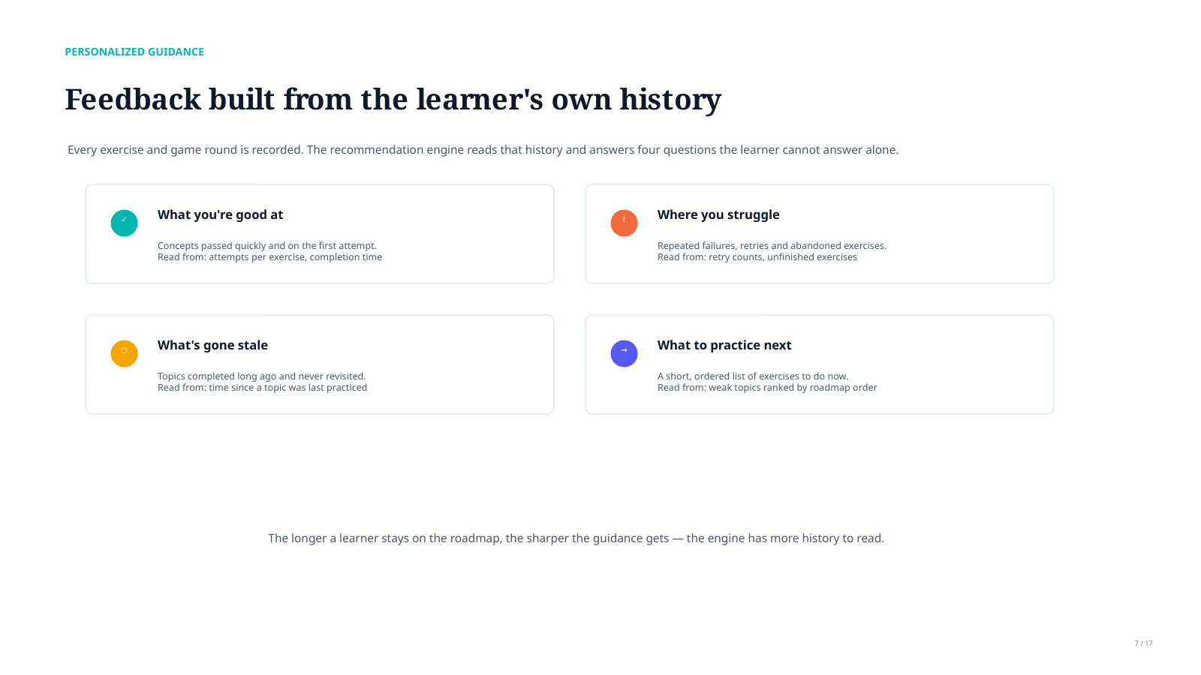

Slide 8
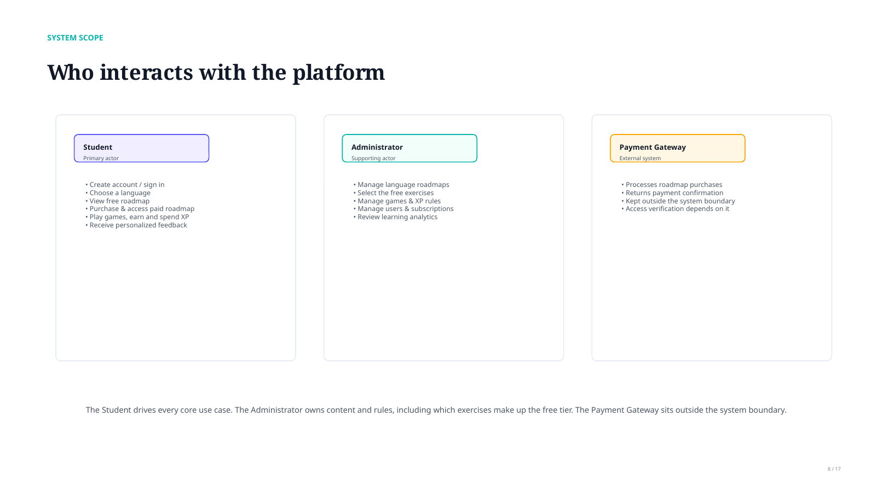

Slide 11
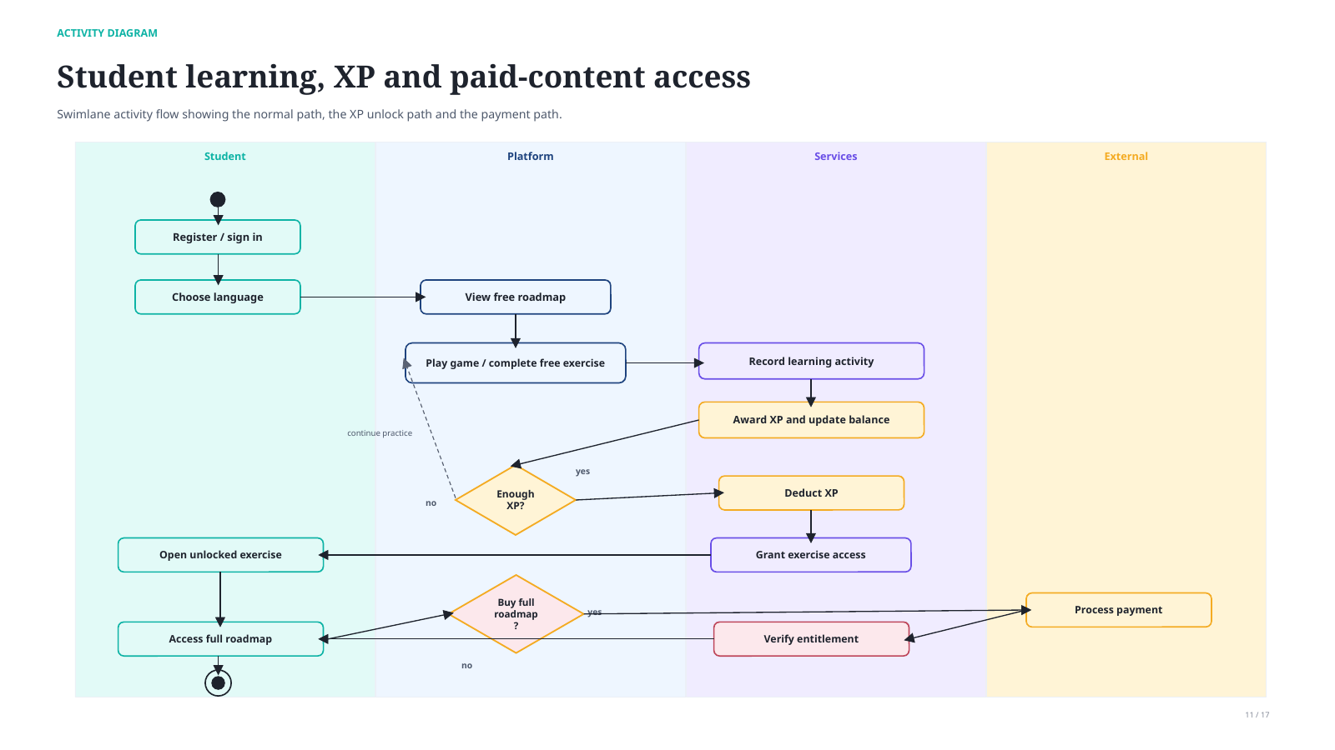

Slide 12
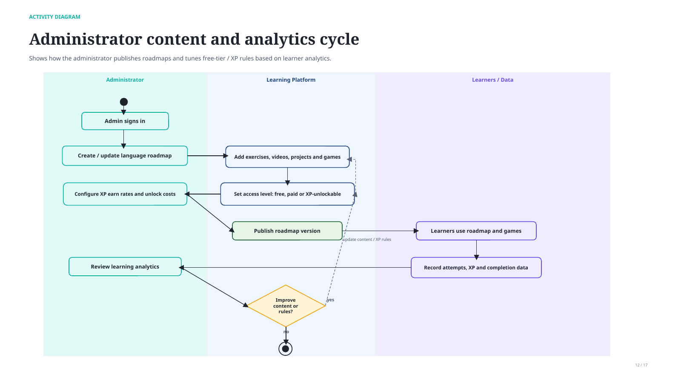

Slide 13
Signup & Email Verification
Client
Auth Ctrl
Crypto/Bcrypt
Database
Email
signup / verify page
auth.controller.ts
node crypto · bcrypt
Supabase RPC + tables
sendVerificationEmail
signup
POST /api/auth/signup — create account, issue verification token
POST /signup { firstName, email,
password }
1.
SELECT users WHERE email = :email
2.
Verification token TTL:
1 hour · stored as
SHA-256 hash ·
consumed once via
consume_token RPC
409 user_exists | null (continue)
3.
bcrypt.hash(password, 10)
4.
INSERT users(email, first_name, password_hash)
5.
issue-token
crypto token · hash · store · dispatch email
crypto.randomBytes(20) → token
6.
rpc('insert_token', sha256(token), 'verify_account_email', +1h)
canSend RPC enforces
per-user email rate
limits before dispatch
7.
sendVerificationEmail(email, token)
8.
Verification link (out-of-band)
9.
Request
Response
Fragment

Slide 14
Admin Page — Request Processing in the Backend
Admin
Admin Page
Express Server
Admin Controller
Supabase
signed-in user
Next.js · axios
cors · json · router
admin.controller.ts
PostgREST + Postgres
request
User action → HTTP request with jwt cookie
click action (e.g. “Update
status”)
1.
9 admin routes: 3 GET · 1 POST · 4 PATCH · 1 DELETE — all mounted at /api/admin
axios.patch
/api/admin/exercise/:id/status
2.
pipeline
cors → express.json → cookieParser → route match
cors · express.json · cookieParser · match /api/admin/...
3.
dispatch
Router → controller function for the matched route
dispatch
changeExerciseStatus(req, res)
4.
7 of 9 endpoints go through Supabase RPCs prefixed admin_* / change_admin_* — the rest hit tables directly
alt
supabase-js path — RPC | direct table op
rpc('change_admin_exercise_status', { p_exercise_id,
p_access_level })
5.
.from('exercise').update({ xp_need }).eq('id', :id)
6.
response
Supabase result → JSON envelope back to the client
{ data, error }
res.json({ data, error: null }) · error →
handleControllerError
7.
Controllers wrap Supabase errors and thrown exceptions in handleControllerError → consistent { data, error } envelope
toast · setState · re-
render
8.
9.
Request
Response
Fragment

Slide 15
Entity–Relationship Diagram — Part 1
PART 1 / 2
Identity & auth · content model · maps & subscriptions
PK
FK
ENUM
users
tokens
exercise
maps
id
BIGINT IDENTITY
id
BIGINT IDENTITY
id
BIGINT IDENTITY
id
BIGINT IDENTITY
first_name
VARCHAR(100)
token
TEXT NOT NULL
title
VARCHAR(100) UNIQUE
name
TEXT NOT NULL UNIQUE
email
TEXT NOT NULL UNIQUE
token_type
token_type
slug
VARCHAR(100) UNIQUE
exercises_id
BIGINT[] DEFAULT '{}'
password
TEXT NOT NULL
expires_at
TIMESTAMPTZ
difficulty
exercise_difficulty
image_url
TEXT
balance
INT DEFAULT 0
revoked
BOOL DEFAULT false
status
exercise_status
exercises_id ↝ exercise.id (array FK, N:N)
is_verified
BOOLEAN
access_level
exercise_access_level
active_status
user_active_status
users_tokens
instructor_id
BIGINT → users(id)
xp_need
INT
map_subscription
user_id
BIGINT → users(id)
id
BIGINT IDENTITY
students
token_id
BIGINT → tokens(id)
user_id
BIGINT → users(id)
user_id
BIGINT PK → users(id)
map_id
BIGINT → maps(id)
languages
status
map_subscription_status
id
BIGINT IDENTITY
price_paid
INT DEFAULT 0
name
VARCHAR(100) UNIQUE
started_at
TIMESTAMPTZ
slug
VARCHAR(100) UNIQUE
expires_at
TIMESTAMPTZ
email_rules
exercise_unlocked
id
BIGINT IDENTITY
id
BIGINT IDENTITY
usage_case
email_usage_case
email_logs
user_id
BIGINT → users(id)
max_per_day
INT DEFAULT 3
user_id
BIGINT → users(id)
exercise_id
BIGINT → exercise(id)
cooldown_unit
time_unit
usage_case
BIGINT → email_rules(id)
sent_at
TIMESTAMPTZ now()
PK = surrogate BIGINT IDENTITY · FK enforced with REFERENCES · Crow’s foot notation: │─ = one ─< = many · ENUM columns use Postgres CREATE TYPE

Slide 16
Entity–Relationship Diagram — Part 2
PART 2 / 2
Games & XP · user progress · taxonomy junction tables
PK
FK
ENUM
games
user_games_score
user_exercise
topic
id
BIGINT IDENTITY
user_id
BIGINT → users(id)
id
BIGINT IDENTITY
id
BIGINT IDENTITY
name
VARCHAR(100) UNIQUE
game_id
BIGINT → games(id)
user_id
BIGINT → users(id)
name
VARCHAR(100) UNIQUE
slug
VARCHAR(100) UNIQUE
last_score_id
BIGINT → attempts(id)
exercise_id
BIGINT → exercise(id)
slug
VARCHAR(100) UNIQUE
challenge_lvls
INT DEFAULT 3
score
INT DEFAULT 0 CHECK(≥0)
status_exercise
user_exercise_status
is_active
BOOL DEFAULT false
difficulty
games_difficulty
time_spent
INT DEFAULT 0 (sec)
PK (user_id, game_id, difficulty)
completed_at
TIMESTAMPTZ NULL
exercise_topic
→ users.id (Part 1)
UNIQUE (user_id, exercise_id)
exercise_id
BIGINT → exercise(id)
topic_id
BIGINT → topic(id)
user_games_attempts
PK (exercise_id, topic_id)
id
BIGINT IDENTITY
video
user_exercise_viewed
user_id
BIGINT → users(id)
id
BIGINT IDENTITY
id
BIGINT IDENTITY
technology
game_id
BIGINT → games(id)
name
VARCHAR(100) UNIQUE
user_id
BIGINT → users(id)
id
BIGINT IDENTITY
score
INT DEFAULT 0 CHECK(≥0)
url
TEXT NOT NULL
exercise_id
BIGINT → exercise(id)
name
VARCHAR(100) UNIQUE
status
games_attempts_status
position
INT NOT NULL
viewed_at
TIMESTAMPTZ now()
slug
VARCHAR(100) UNIQUE
difficulty
games_difficulty
is_active
BOOL DEFAULT false
UNIQUE (user_id, exercise_id)
→ users.id (Part 1)
→ users.id, exercise.id (Part 1)
exercise_technology
exercise_video
exercise_id
BIGINT → exercise(id)
exercise_id
BIGINT → exercise(id)
technology_id
BIGINT → technology(id)
video_id
BIGINT → video(id)
PK (exercise_id, technology_id)
PK (exercise_id, video_id)
→ exercise.id (Part 1)
→ exercise.id (Part 1)
Cross-slide FKs shown as grey badges referencing Part 1 · junction tables use composite primary keys · ENUM columns use Postgres CREATE TYPE

Slide 17
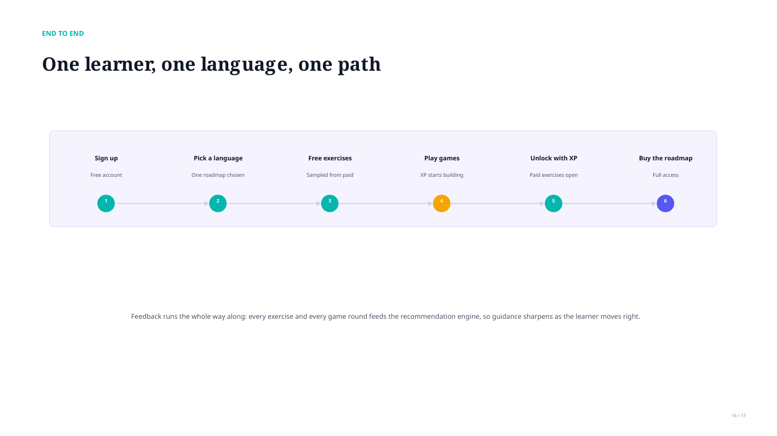

Slide 18
